Slide 1
“Structure, Ideology, Traditions”: Defining the Akkadian State
By: Dan Hulseapple

Slide 2
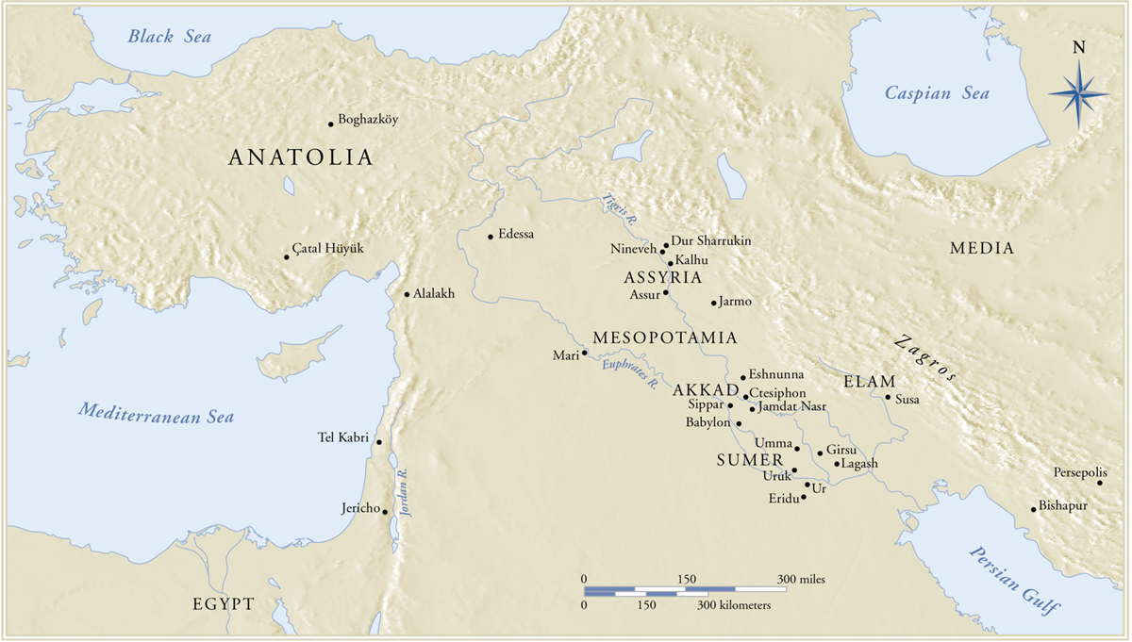
Notes:
Localized politics, generally
Emphasis on the city state and the local pantheon
Occasional trade and defense agreements

Slide 3
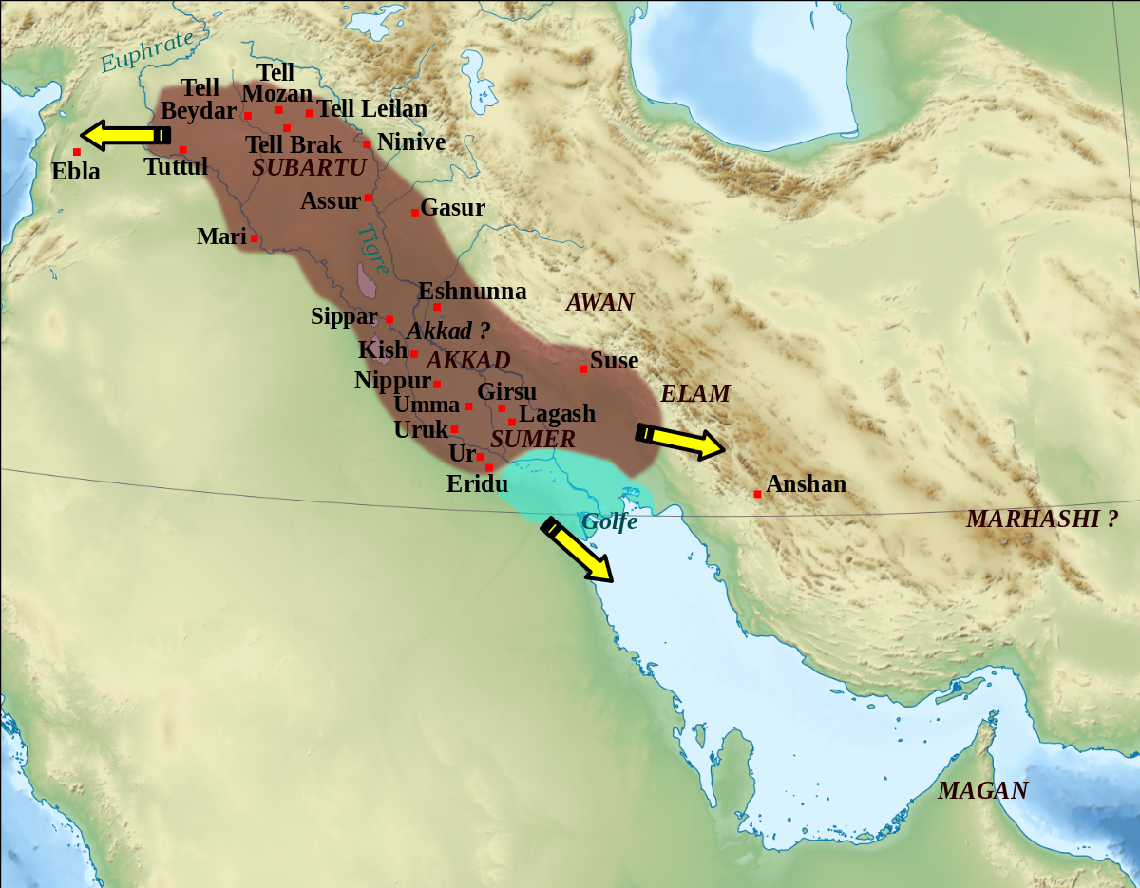

Slide 4
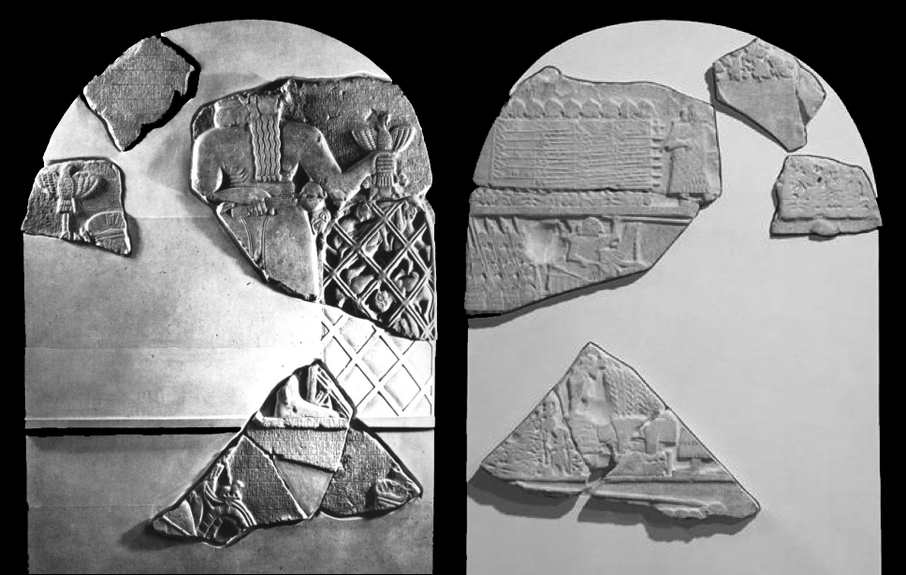
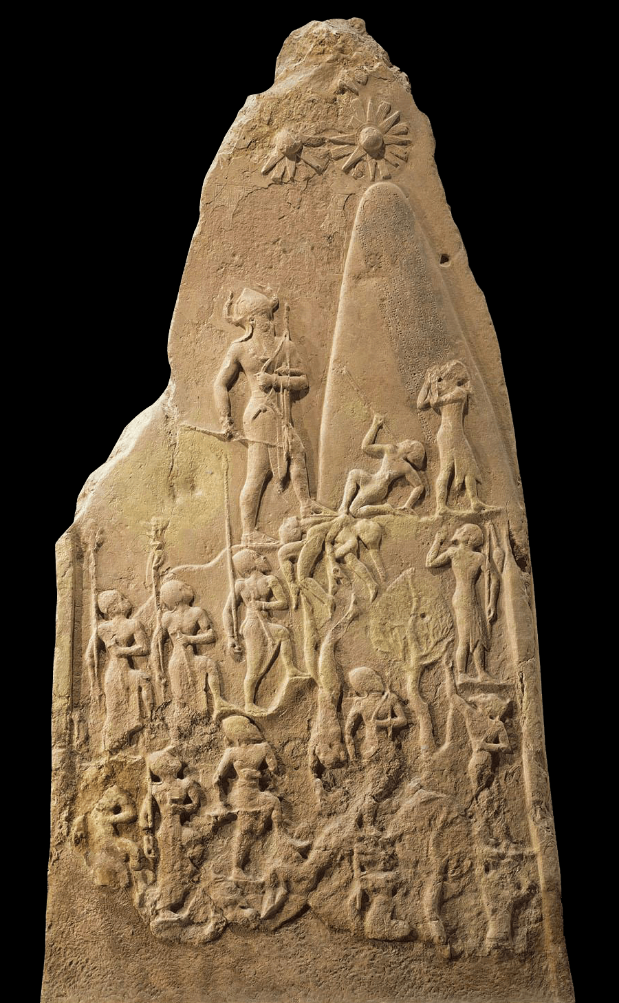
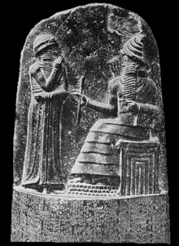
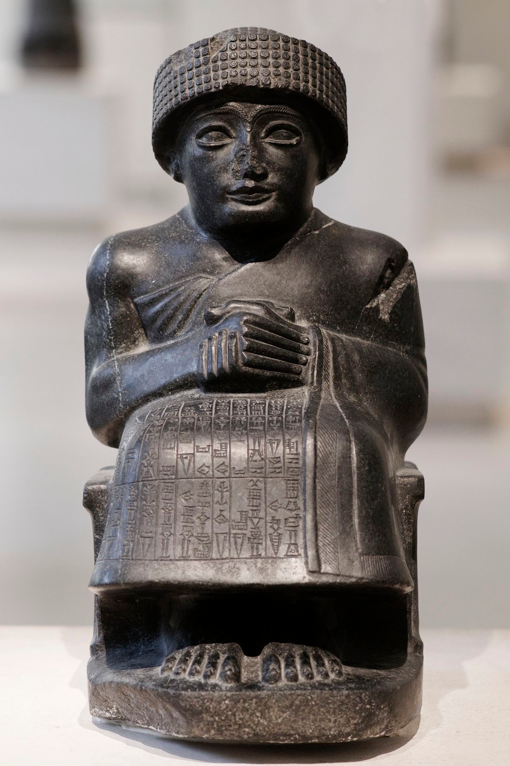
A Brief History of Ancient Mesopotamia
ca. 2900 BCE
ca. 331 BCE
2334
2154
2112
2004
1830
1750
1531
1155
911
629
612
539
Middle and Neo-Assyrian Period
Persian Period
Early Dynastic Period
Reign of Hammurabi
Neo-Babylonian Period
(New Babylon)
Akkadian Period
Sumerian Renaissance
Old Babylon
Alexander the Great conquers Persia

Slide 5
Central questions
Main question: How can we understand and define the Akkadian state? Can we call it an empire?
How did the Akkadians conceptualize kingship and governance differently than their Sumerian predecessors?
What can we really say about a state that existed over 4,000 years ago?
What made the Akkadian state unique? How did it function practically?

Slide 6
Methodological Problems
Cultural gap in artistic interpretation
Evidence mainly (but not exclusively) from Babylonia
Impersonal; hard to tell how people felt and thought about the Akkadians
Texts copied and altered later on

Slide 7
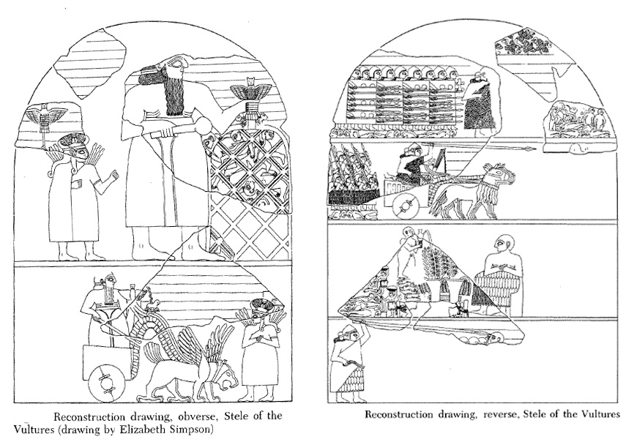
Stele of the Vultures/Eannatum, Sumerian, ca. 2500-2400 BCE
Obverse Reverse
Notes:
To understand Akkad’s innovations, we need to understand what came before
This stele depicts a battle for the city state of Lagash
Stylistically, this is very Sumerian
Oddly proportioned figures
Registers
The iconography emphasizes Sumerian kings’ need to express piety
Separate realms for the divine and human
The realm of the divine shows the god Girsu smiting a net full of enemies, implying that it is he, not Eannatum, who deserves credit for the victory
The inscription emphasizes piety as well
“He [erected for him (Ningirsu)] the monument of Gu’edena, the beloved field of Ningirsu, which Eanatum restored to Ningirsu’s control.”
This is a bit different from what the iconography implies, but it definitely still places the wishes of the divine at the top of the list, so to speak

Slide 8
“He [erected for him (Ningirsu)] the monument of Gu’edena, the beloved field of Ningirsu, which Eanatum restored to Ningirsu’s control.”
(Inscription from the stele)

Slide 9
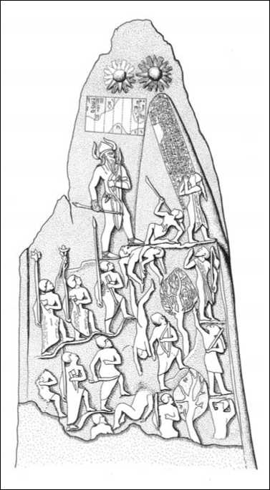
Victory Stele of Naram-Sin, Akkadian, ca. 2200 BCE
Notes:
This is the apex of Akkadian art
There are lots of steps before we get to this point, but we have a limited time
Stylistically this is profoundly not Sumerian
No registers
High degree of realism and plasticity in the figures, comparatively
This also best encapsulates the entire Akkadian conception of kingship
Naram-Sin’s body is well formed and muscular
This embodies the Akkadian word kuzbu, meaning virility, potency, and masculinity
His carrying weapons symbolizes that too
Behind Naram-Sin there are orderly rows of soldiers, while in front of him there is chaos and slaughter
Emphasizes the idea that the Akkadians were bringers of order to a chaotic region
The trees on the mountain are specific to the region being conquered (the Lullubi peoples in the Zagros mountains)
By doing this, this monument is communicating not just that people in general were conquered by the Akkadians, but that these specific people were conquered.
Naram-Sin’s crown and his proximity to the three celestial figures above him are symbols of divinity
Here the Akkadians erased the distinction between the divine and mortal realms
This comes across in texts too
In short, the Akkadian conception of kingship:
Was centered around the individual character of the king
Held the Akkadian king not just to be king, but a king over kings
Shar-kali-sharri

Slide 10
“The god Enlil (is) his (personal) deity (and) the god Ilaba, mighty one of the gods, is his clan (god). *Naram-Sin, the mighty king of the four quarters.” (Naram-Sin E2.1.4.6)

Slide 11
Administering the Akkadian State
Administrative records
Archaeological reports
Royal inscriptions
Votive statuary

Slide 12
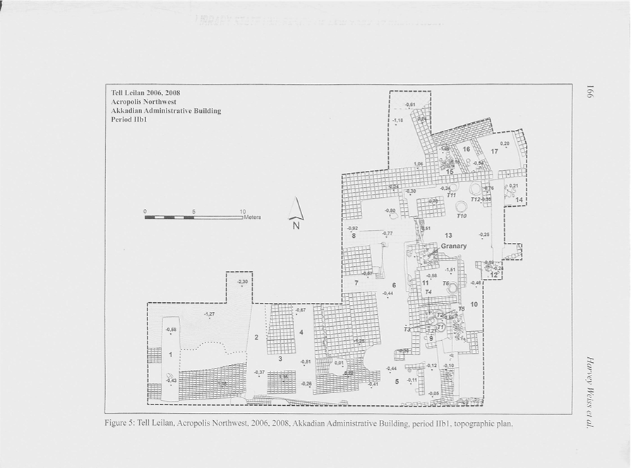
Tell Leilan Excavations
Notes:
Seal inscribed with the name of an Akkadian official (shabra-e).
Storage vessels, grain processing tools, tannurs, and cereal grain ash
Was probably used to collect, store, process, and distribute grain
Forced relocation?

Slide 13
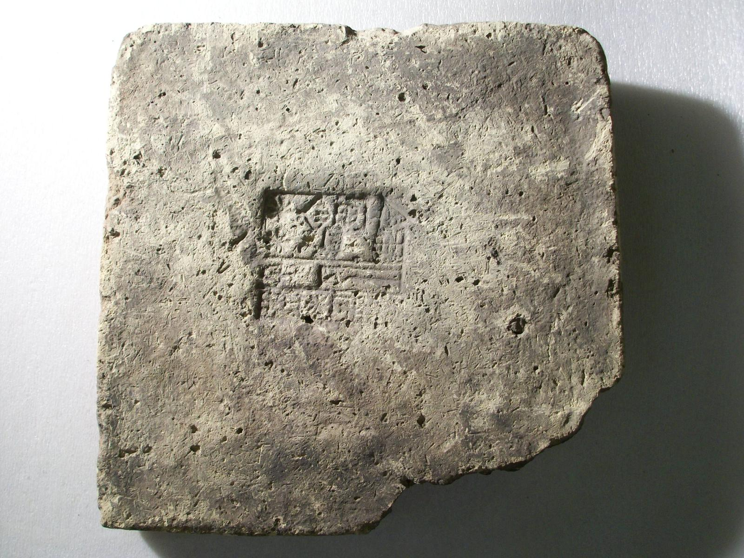

Slide 14
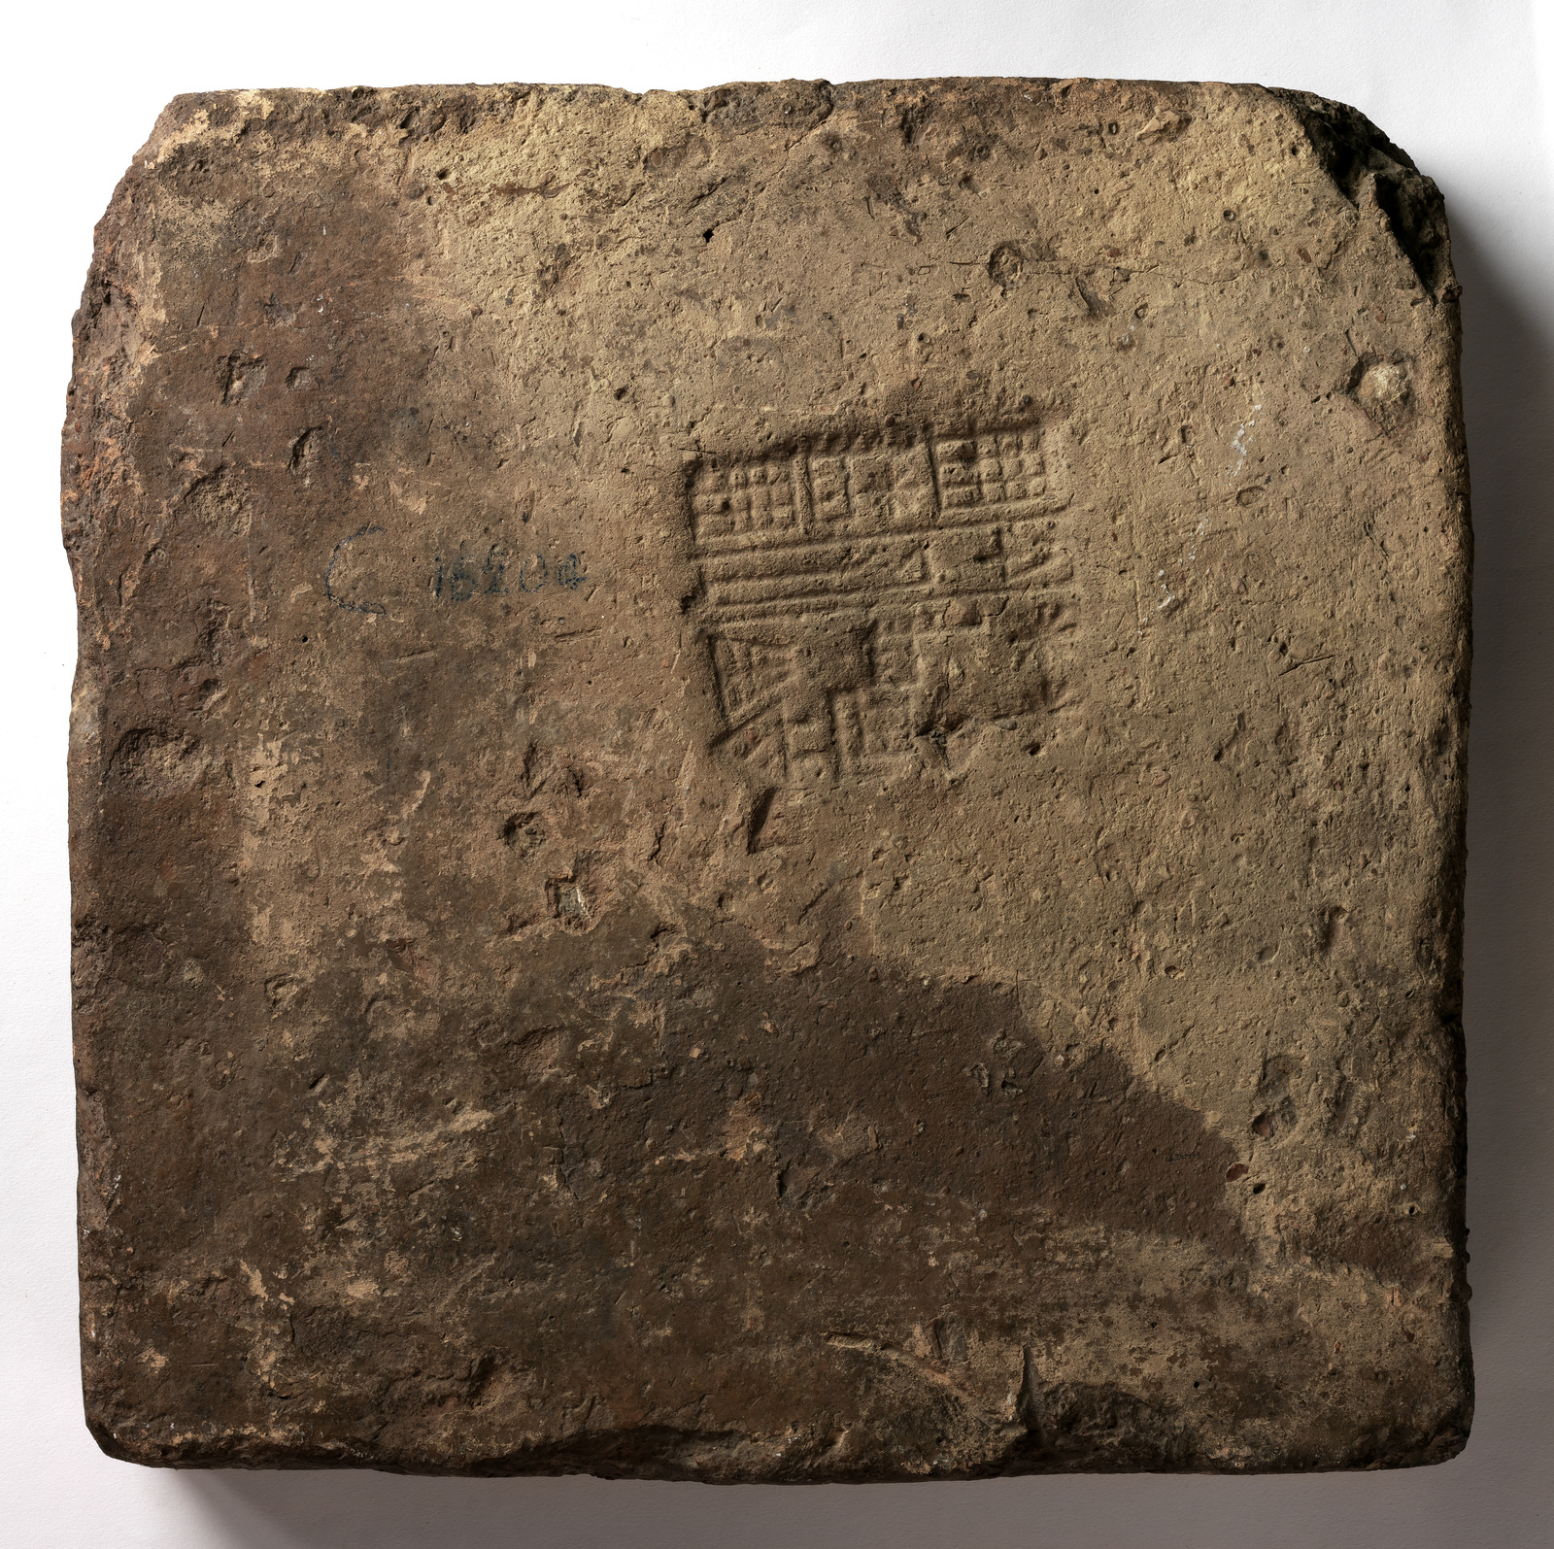

Slide 15
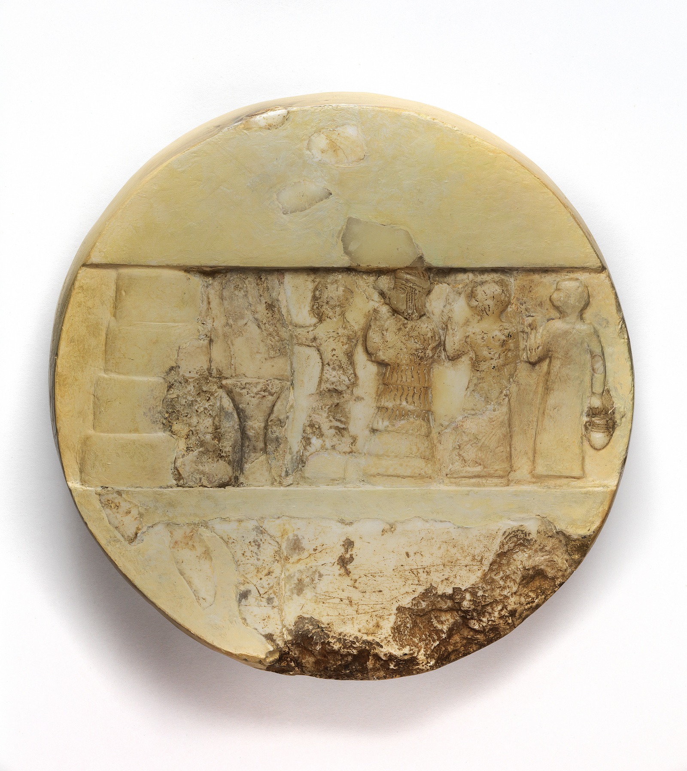
Religious Legitimacy and Patronage
Disc of Enheduanna, Akkadian, ca. 2334-2200 BCE
Notes:
Strategic use of Sumerian religious practices
Sumerian artistic style
Sumerian office
Sumerian gods
Akkadian twist
Sargon, Naram-Sin, Shar-kalli-sharri all appointed daughters to this office

Slide 16
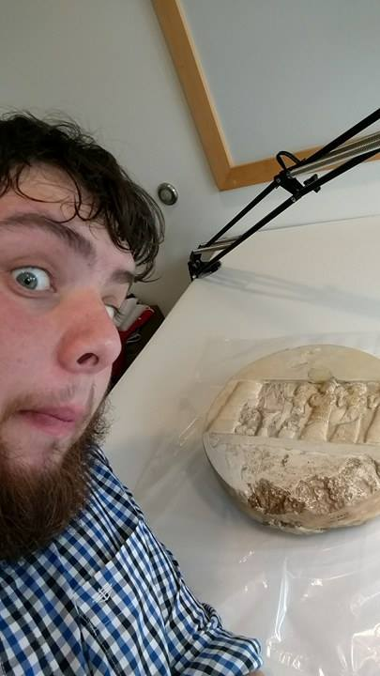

Slide 17
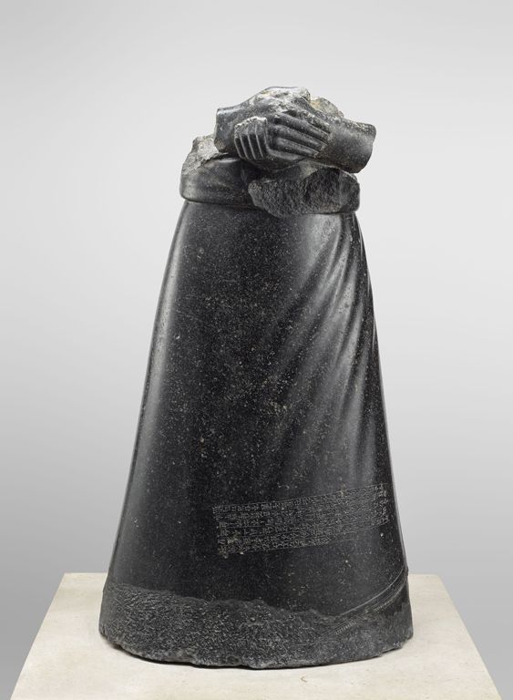
Statue of Manishtushu, Akkadian, ca. 2250 BCE
Notes:
Found at Nippur, Ur, Sippar, and Susa

Slide 18
Standard inscription:
“He fashioned a statue of himself (and) dedicated (it) to the god [Enlil]. By the gods Shamash and Ilaba I swear that (these) are not falsehoods (but) are indeed true. As for the one who removes this inscription, may the gods Enlil and Shamash tear out foundations and destroy his progeny… Manishtushu, king of the world, dedicated (this object) to the god Enlil.”

Slide 19
What do we make of this? Is Akkad an empire?

Slide 20
Different theories/approaches
Doyle (1986), Smith (2001)
Political/economic cores
Subservient peripheries
“Transnational” system and its needs
Incentives offered by the wider political climate
Sinopoli (2001)
Form vs. substance
Subrahmanyam (2001)
Minimalist approach
Large geographic size
Hierarchical ruling structure
Imperial ideology that espouses the state’s supremacy

Slide 21
My definition
Empires are states which:
Exert political, economic, or cultural influence
Over a relatively large geographic area
With a culturally heterogeneous population
Driven by an imperial ideology which acknowledges the empire as ruling over different peoples

Slide 22
Applying this Definition
Features of the Akkadian State:
Exert political, economic, or cultural influence? → Yes
Tell Leilan complex
Potential population redistribution
Princesses as high priestesses
Over a relatively large geographic area? → Yes
Controlled all of Mesopotamia, at least
With a culturally heterogeneous population? → Yes
Sumerians and Akkadians
Lullubi
Elamites
Driven by an imperial ideology which acknowledges the empire as ruling over different peoples → Yes
“Four Quarters”
Enheduanna Disc and hymns
Royal patronage

Slide 23
Questions for further research
Further questions
To what extent does Akkad have the form of empire, rather than the substance of empire?
Is there solid evidence for Akkadian imperialism in areas they claimed to conquer outside of Mesopotamia?
How was the Akkadian imperial tradition actively acknowledged and engaged with by later empires? How far does the Akkadian tradition reach?

Slide 24
Select bibliography
Barfield, Thomas J. "The Shadow Empires: Imperial State Formation along the Chinese-Nomad Frontier." In Empires: Perspectives from Archaeology and History, edited by Thomas J. Barfield, Susan E. Alcock, Kathleen D. Morrison, and Carla M. Sinopoli, 10-41. New York: Cambridge University Press, 2001.
Doyle, Michael W. Empires. Ithaca, NY: Cornell University Press, 1986.
Eppihimer, Melissa. "Assembling King and State: The Statues of Manishtushu and the Consolidation of Akkadian Kingship." American Journal of Archaeology 114, no. 3 (July 2010), 365-380.Foster, Benjamin R. "The Sargonic Victory Stele from Telloh." Iraq 47 (1985): 15-30. doi:10.2307/4200229.
Frayne, Douglas, editor and translator. The Sargonic and Gutian Periods (2334-2113 BC). The Royal Inscriptions of Mesopotamia, Early Periods Volume 2. Toronto: Toronto University Press, 1993.
Howe, Stephen. Empire: A Very Short Introduction. New York: Oxford University Press, 2002.Michałowski,
Piotr. "Memory and Deed: The Historiography of the Political Expansion of the Akkad State." In Akkad, the First World Empire: Structure, Ideology, Traditions, edited by Mario Liverani, 69-89. Rome: Padova, 1993.
Ristvet, Lauren. "The Development of Underdevelopment? Imperialism, Economic Exploitation, and Settlement on the Khabur Plains, ca. 2300-2200 BC." In Seven Generations since the Fall of Akkad, edited by Harvey Weiss, 241-260. Wiesbaden: Harrassowitz-Verlag, 2012.

Slide 25
Select bibliography, continued
Sinopoli, Carla M. “The Archaeology of Empire,” in Annual Review of Archaeology 23, (1994): 159-181.
Steinkeller, Piotr and J.N. Postgate, editors. Third-Millennium Legal and Administrative Texts in the Iraq Museum, Baghdad. Winona Lake, Indiana: Eisenbrauns, 1992.
Subrahmanyam, Sanjay. “Written on Water: Designs and Dynamics in the Portuguese Estado da India.” In Empires: Perspectives from Archaeology and History, edited by Thomas J. Barfield, Susan E. Alcock, Kathleen D. Morrison, and Carla M. Sinopoli, 42-69. New York: Cambridge University Press, 2001.
Weiss, Harvey, Sturt W. Manning, Lauren Ristvet, Lucia Mori, Mark Besonen, Andrew McCarthy, Philippe Quenet, Alexia Smith, and Zainab Bahrani. "Tell Leilan Akkadian Imperialization, Collapse and Short-Lived Reoccupation Defined by High Resolution Radiocarbon Dating." In Seven Generations since the Fall of Akkad, edited by Harvey Weiss, 163-192. Wiesbaden: Harrassowitz-Verlag, 2012.
Westenholz, Aage. "The World View of Sargonic Officials. Differences in Mentality Between Sumerians and Akkadians." In Akkad, the First World Empire: Structure, Ideology, Traditions, edited by Mario Liverani, 157-169. Rome: Padova, 1993.
Winter, Irene J. "Women in Public: The Disk of Enheduanna, the Beginning of En-Priestess and the Weight of Visual Evidence." In On Art in the Ancient Near East: Volume II, From the Third Millennium BCE, edited by Thomas Schneider, Eckart Frahm, W. R. Garr, B. Halpern, and Theo P. J. Van den Hout, 65-83. Leiden: Brill, 2010.

